Slide 1
Opentrons challenge
Allan Li, Zixian Ma

Slide 2
What is the challenge?
Use the OT-2 Robot to automate a laboratory protocol
Add functionalities (e.g. sensors) to the robot to expand the range of protocols it can perform

Slide 3
How did we come up with the idea?
Problems in biology lab
Imperfect environment
Repetitive tasks
Utilities of Opentrons
Closed environment (vacuum, UV light)
Automation (stirring, opening & closing lids, streaking)

Slide 4
What is streaking & Why is it important to automate this process?
a technique used to isolate a pure strain from a single species of microorganism, often bacteria
Manual streaking?
Non-sterilized environment
Low precision
Waste of time

Slide 5
What did we do?
Create Petri Dish holder
3D printing
Modify OT2’s movement
Defining a function for streaking (suitable for round petri dish of any size)
From moving across wells to moving according to coordinates

Slide 6
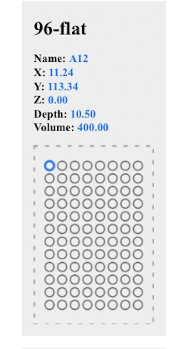

Slide 7
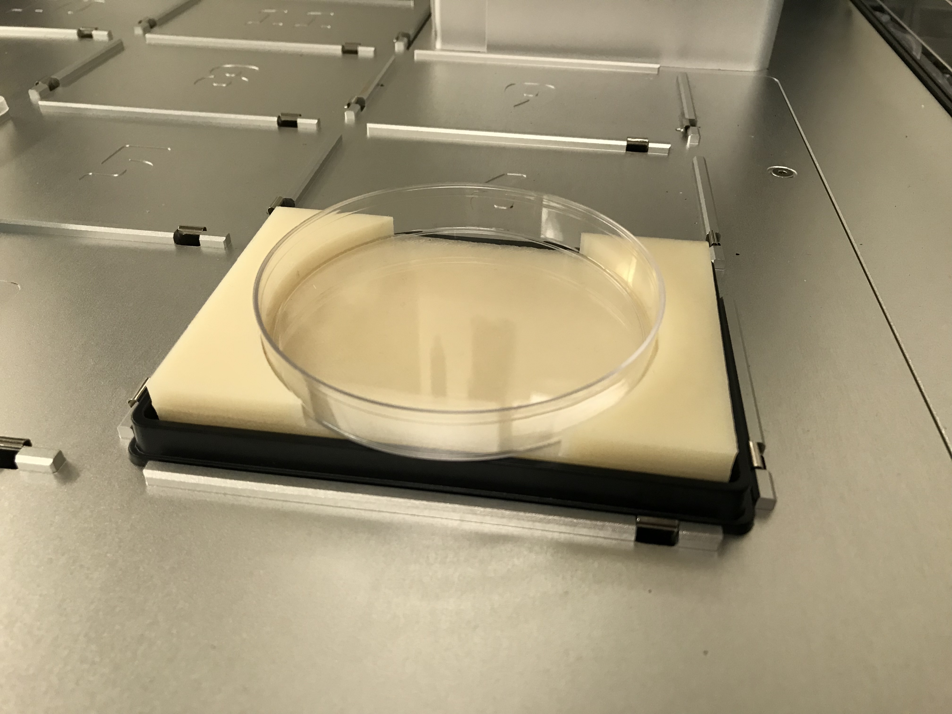
Results

Slide 8
Demo Video

Slide 9
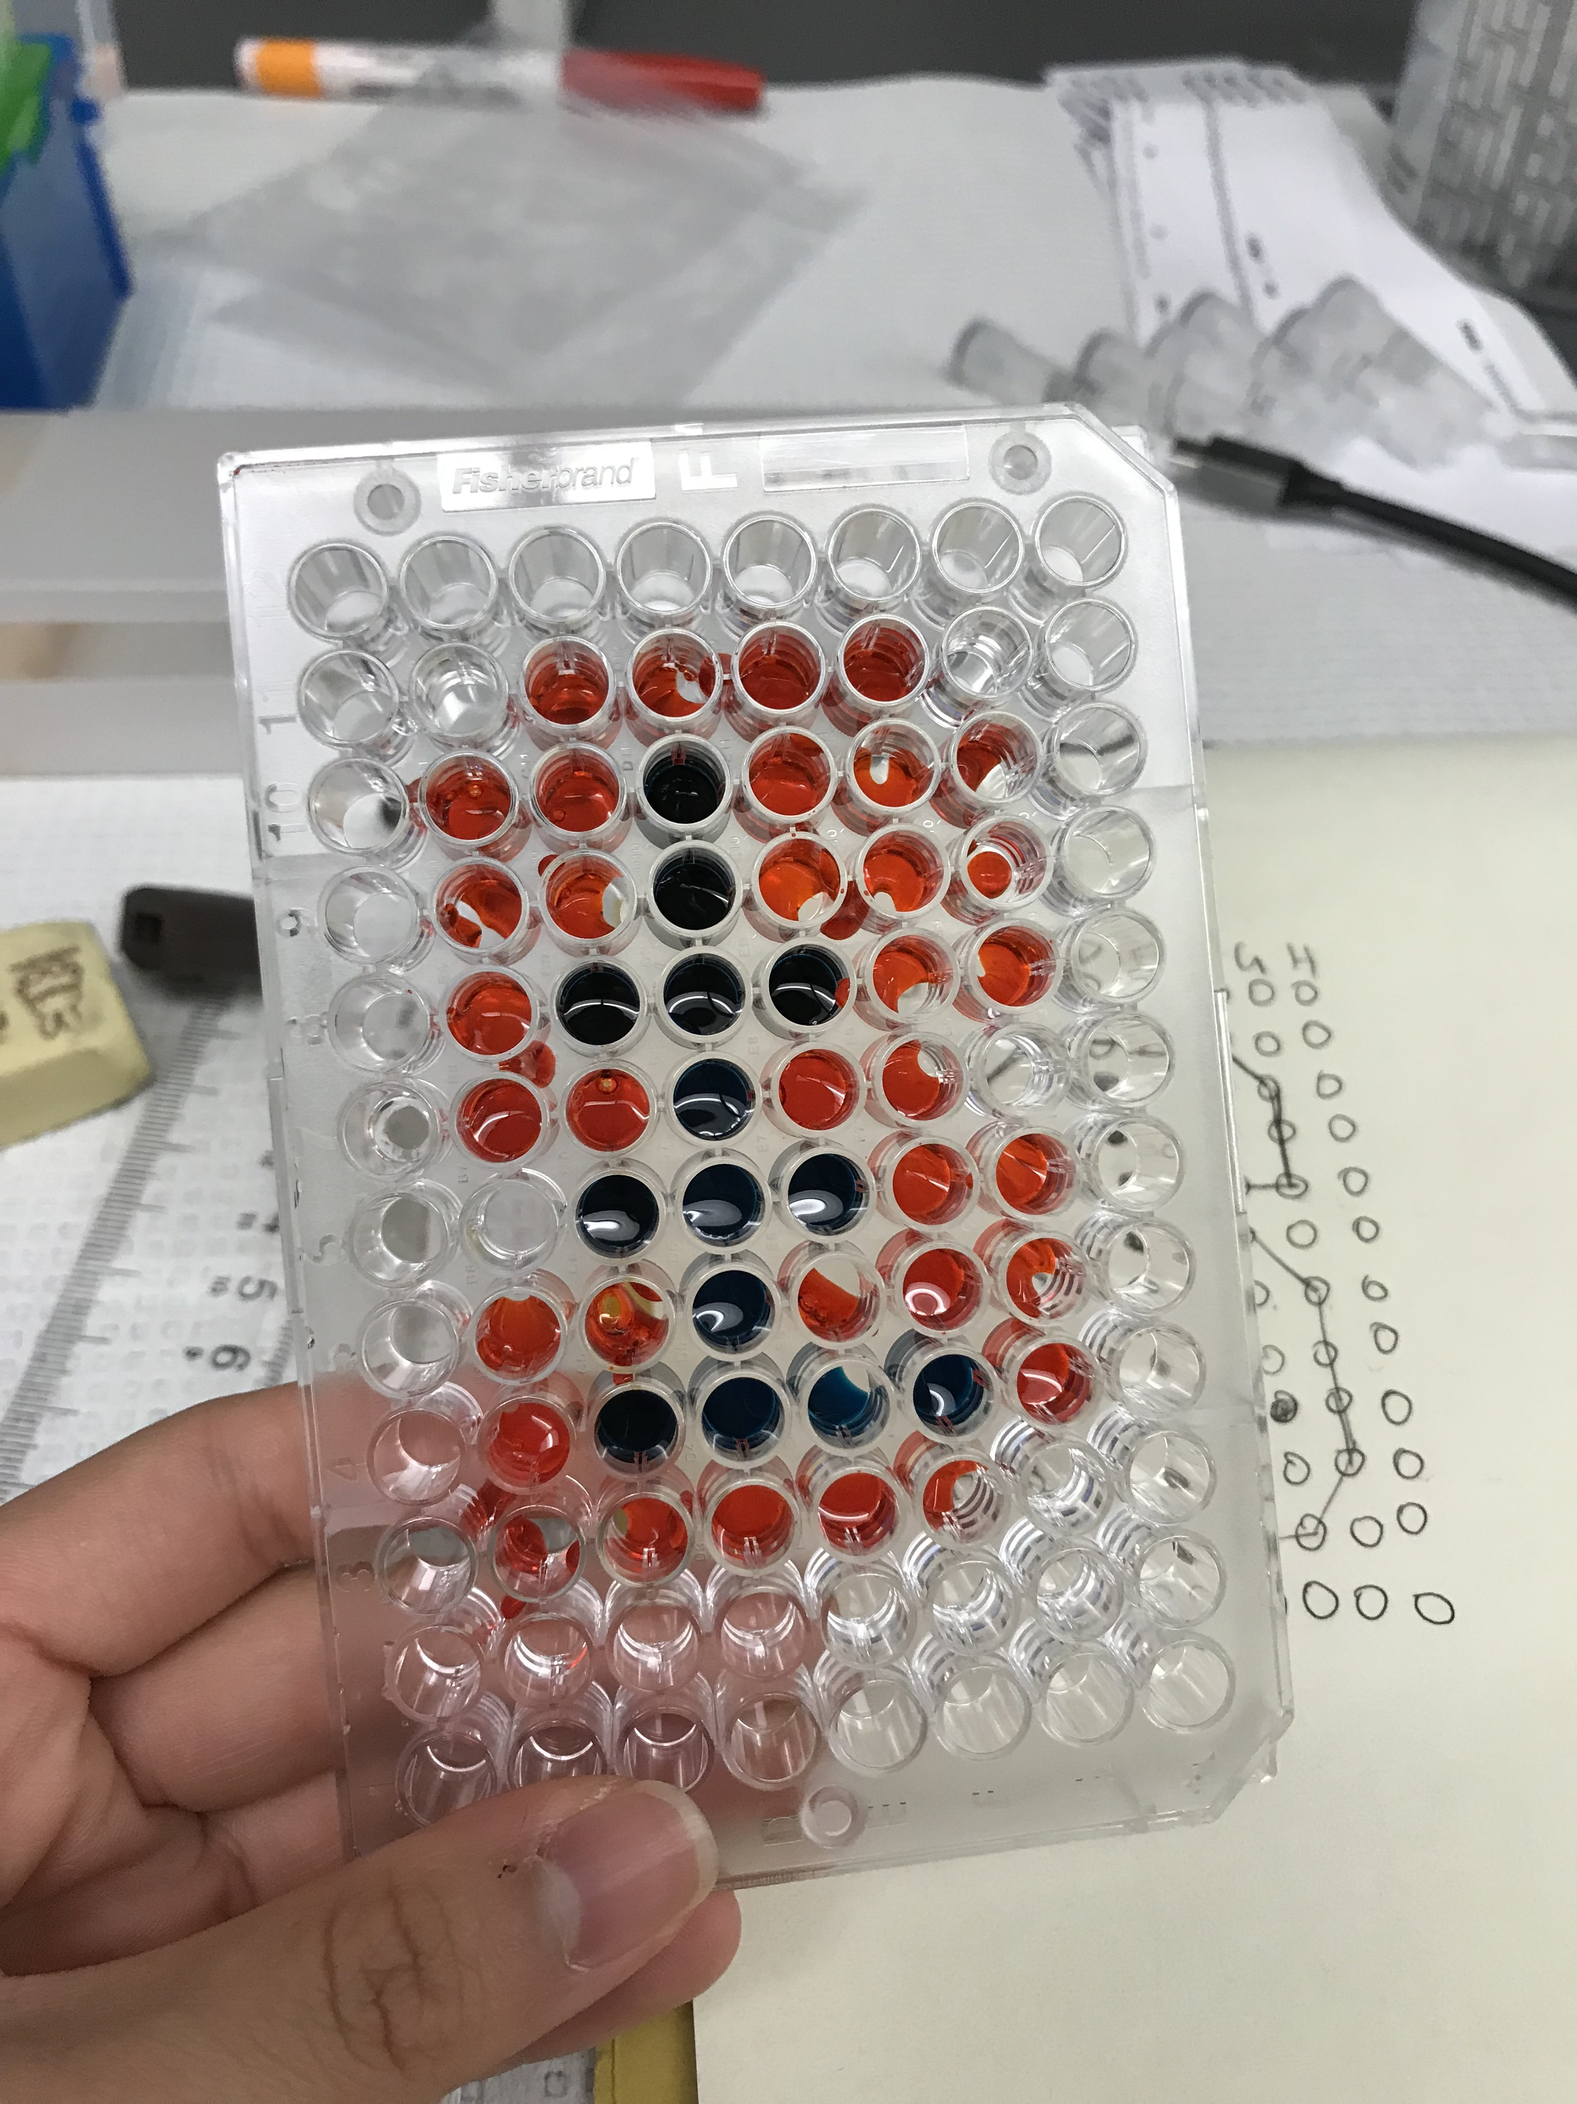
Just for Fun
Using Opentrons to draw a Stanford logo

